Slide 1







BANDANA SHARMA
DATA ANALYST
Chocolate- Rating
SKILLS AND TOOLS
Motivation and Objective
Chocolate stands as the most favored sweet indulgence globally, celebrated for its exceptional flavor with roots tracing back to ancient times. The Maya revered chocolate, particularly a cocoa beverage prepared with hot water, deeming it the "Food of the Gods."
-There is a common assumption that European chocolate is the best globally, and this analysis aims to verify its accuracy. Additionally, the analysis will explore other factors contributing to the best chocolate flavor.
Maybe introducing new flavor in market.
SKILLS
Data Sourcing
Exploring Relationships
Geographical Visualization
Unsupervised/Supervised machine learning
Sourcing& Analyzing time series data
TOOLS
Python
Tableau
Githhub
PowerPoint
Project Info
Project Brief
Data set
Tableau Link
Github Link
2024

Slide 2

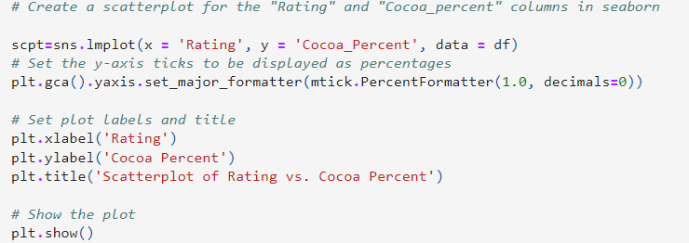
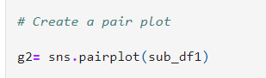
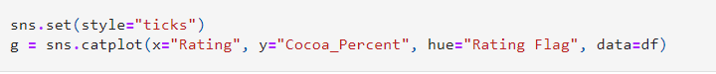
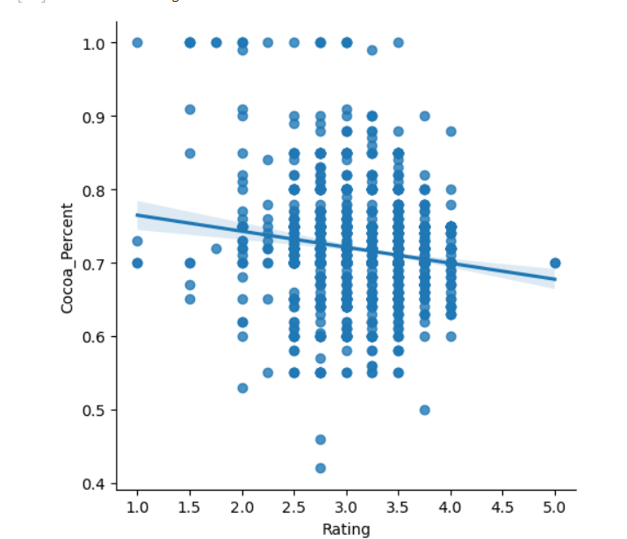
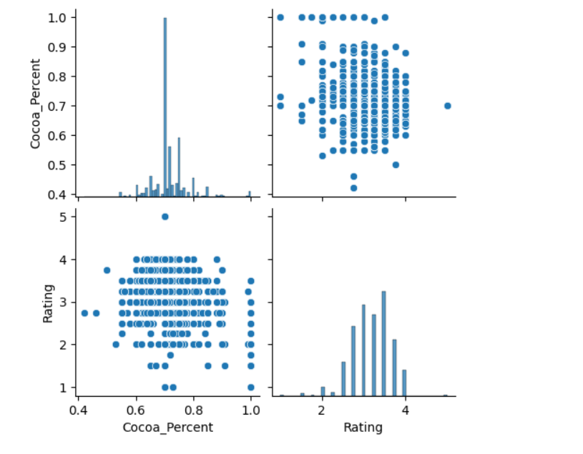
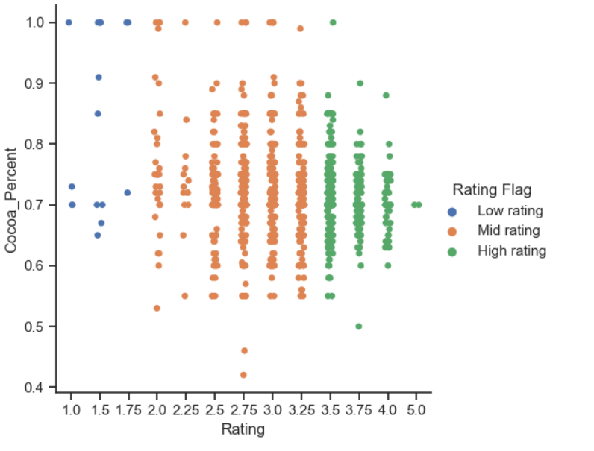
BANDANA SHARMA
DATA ANALYST
Data Analysis
The correlation between the cocoa percentage and the chocolate rating did not exhibit a discernible trend.
Trends in Python
Exploring Relationships wit Pair plot
.
Clustering Categorical plot.
Image 1.
2024

Slide 3
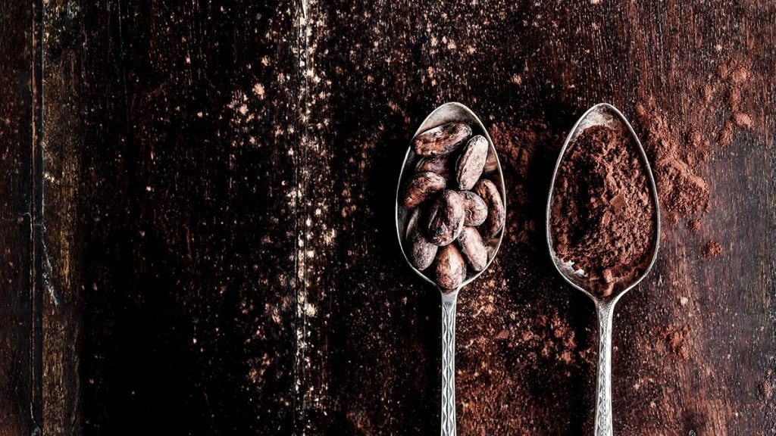
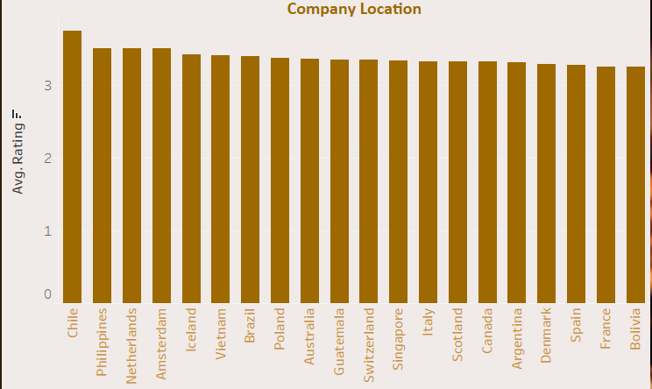
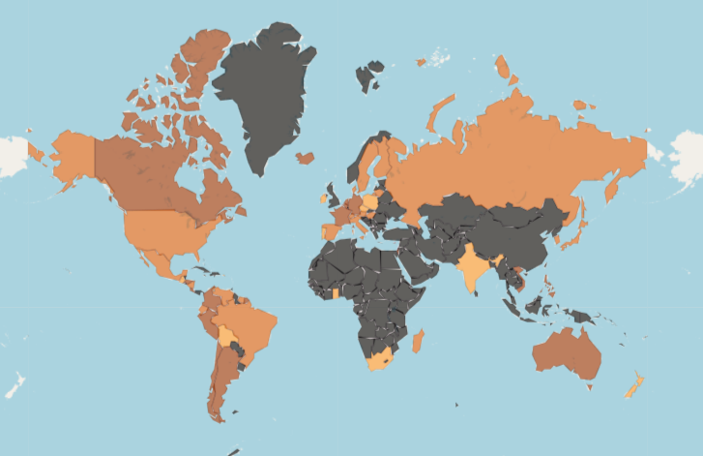
Data Visualization
DATA ANALYST
BANDANA SHARMA
Image 2.
Geographical Map created in python- showing where the highest rating of chocolate are. The higher the rating, the darker the shade of brown. However, countries with a black shade did not participate in the chocolate rating
Image 1.
Here are top 20 Countries with average highest chocolate rating
Chile Hold the highest rating then Philippines, Netherland and so forth among all countries for their chocolate samples.
2024

Slide 4

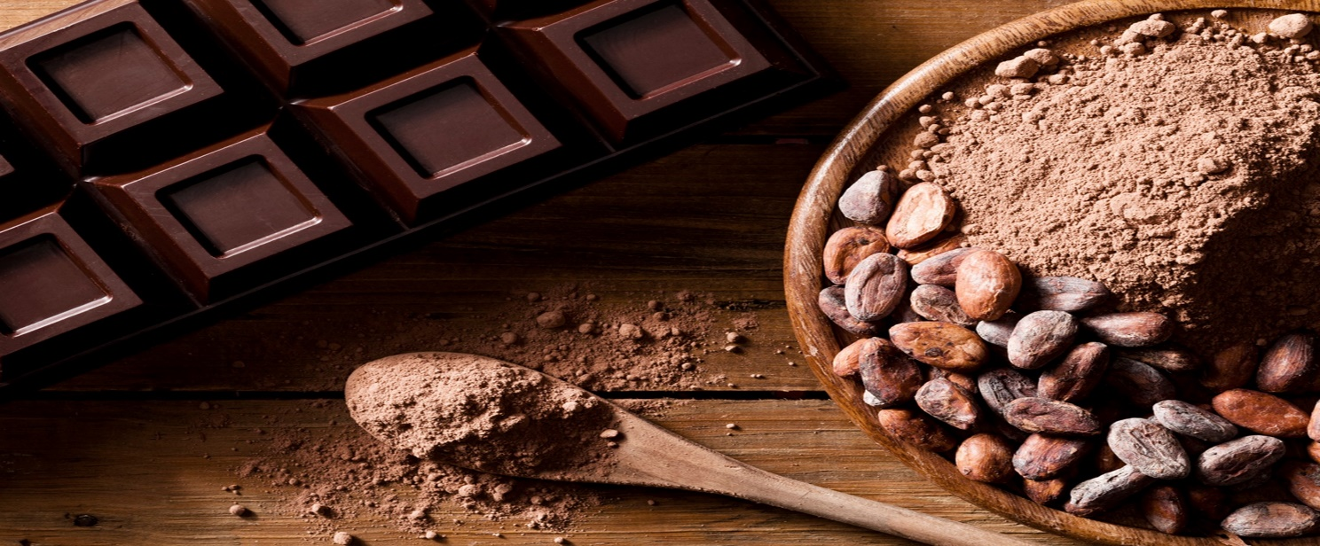
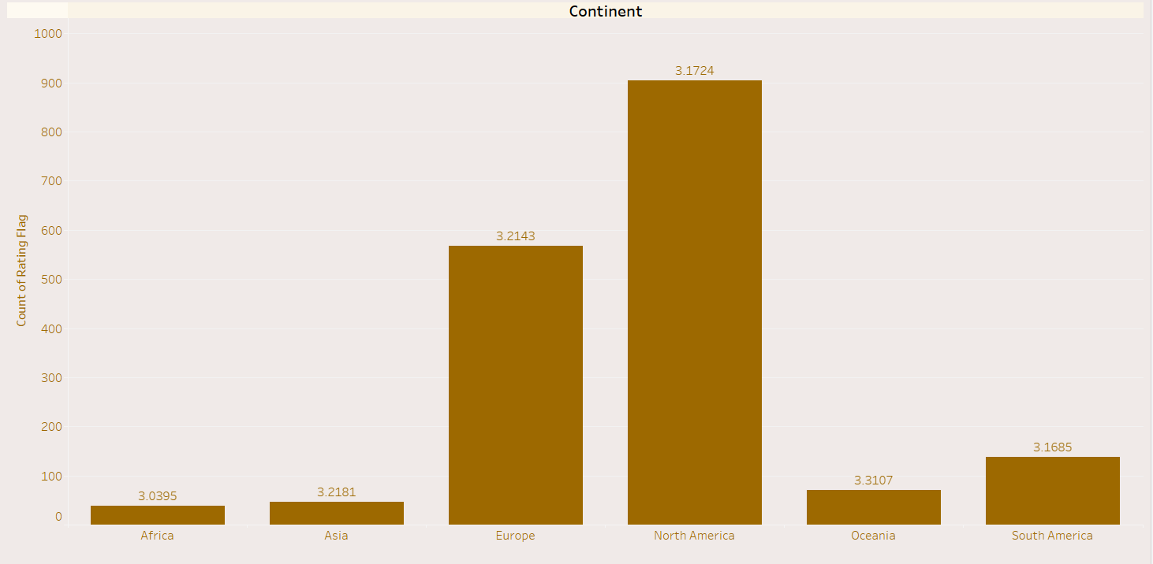
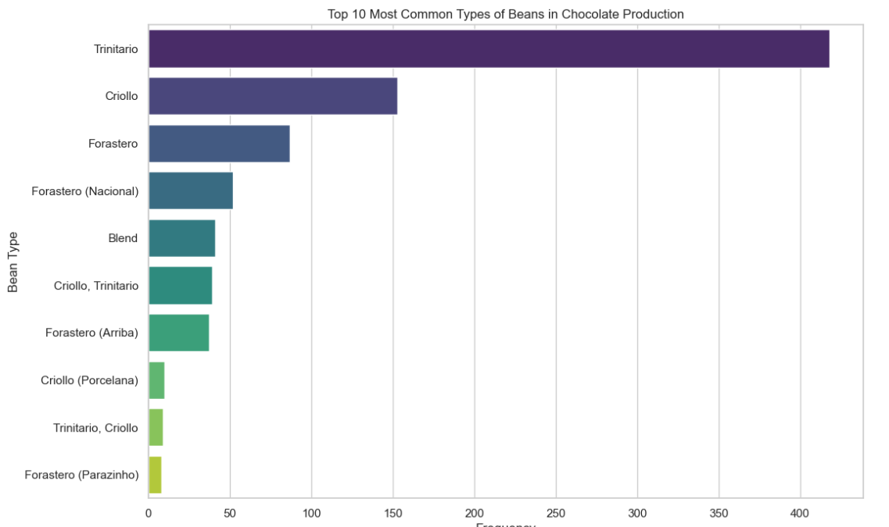
BANDANA SHARMA
DATA ANALYST
Data Visualization Cont.
Images
While a greater number of samples originated from North America, the chocolate samples from Oceania received higher ratings
Here are top 10 bean types of Cocoa bean used all over the world.
2024

Slide 5
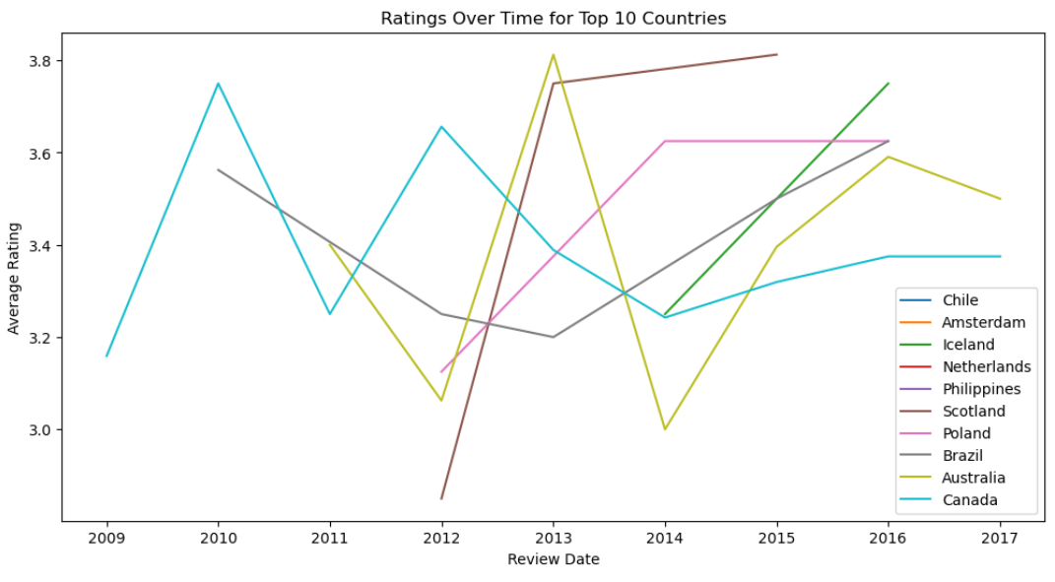
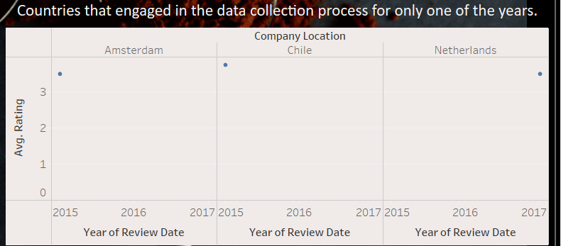
BANDANA SHARMA
DATA ANALYST
Data Visualization Cont.
Some countries didn't exhibit any discernible trend over time, primarily because they participated only once during the data collection timeframe
Extra
Average Chocolate rating Over time from Top 10 countries
2024

Slide 6

BANDANA SHARMA
DATA ANALYST
Recommendations For Chocolate Rating
Recommendation 1
Recommendation 2
Recommendation 3
We can confidently dispel the assumption that European chocolate is inherently the best in the world based on our analysis. By exploring chocolates from various countries and adjusting our marketing strategy, we can enhance the overall taste profile and offer a superior chocolate experience
Due to limitations within the available data, including instances where countries did not participate in all years and missing values for bean types, we may consider exploring additional datasets to conduct a more comprehensive study on the quality and taste of chocolates.
There is evidently no straightforward correlation between the cocoa percentage and the flavor rating of chocolate. Exploring alternative datasets may reveal additional factors influencing chocolate taste and contribute to achieving higher ratings
2024

